Slide 1
µCoaching
When goals become reality...
Filip Gulán, Jan Herec, Marek Marušic

Slide 2
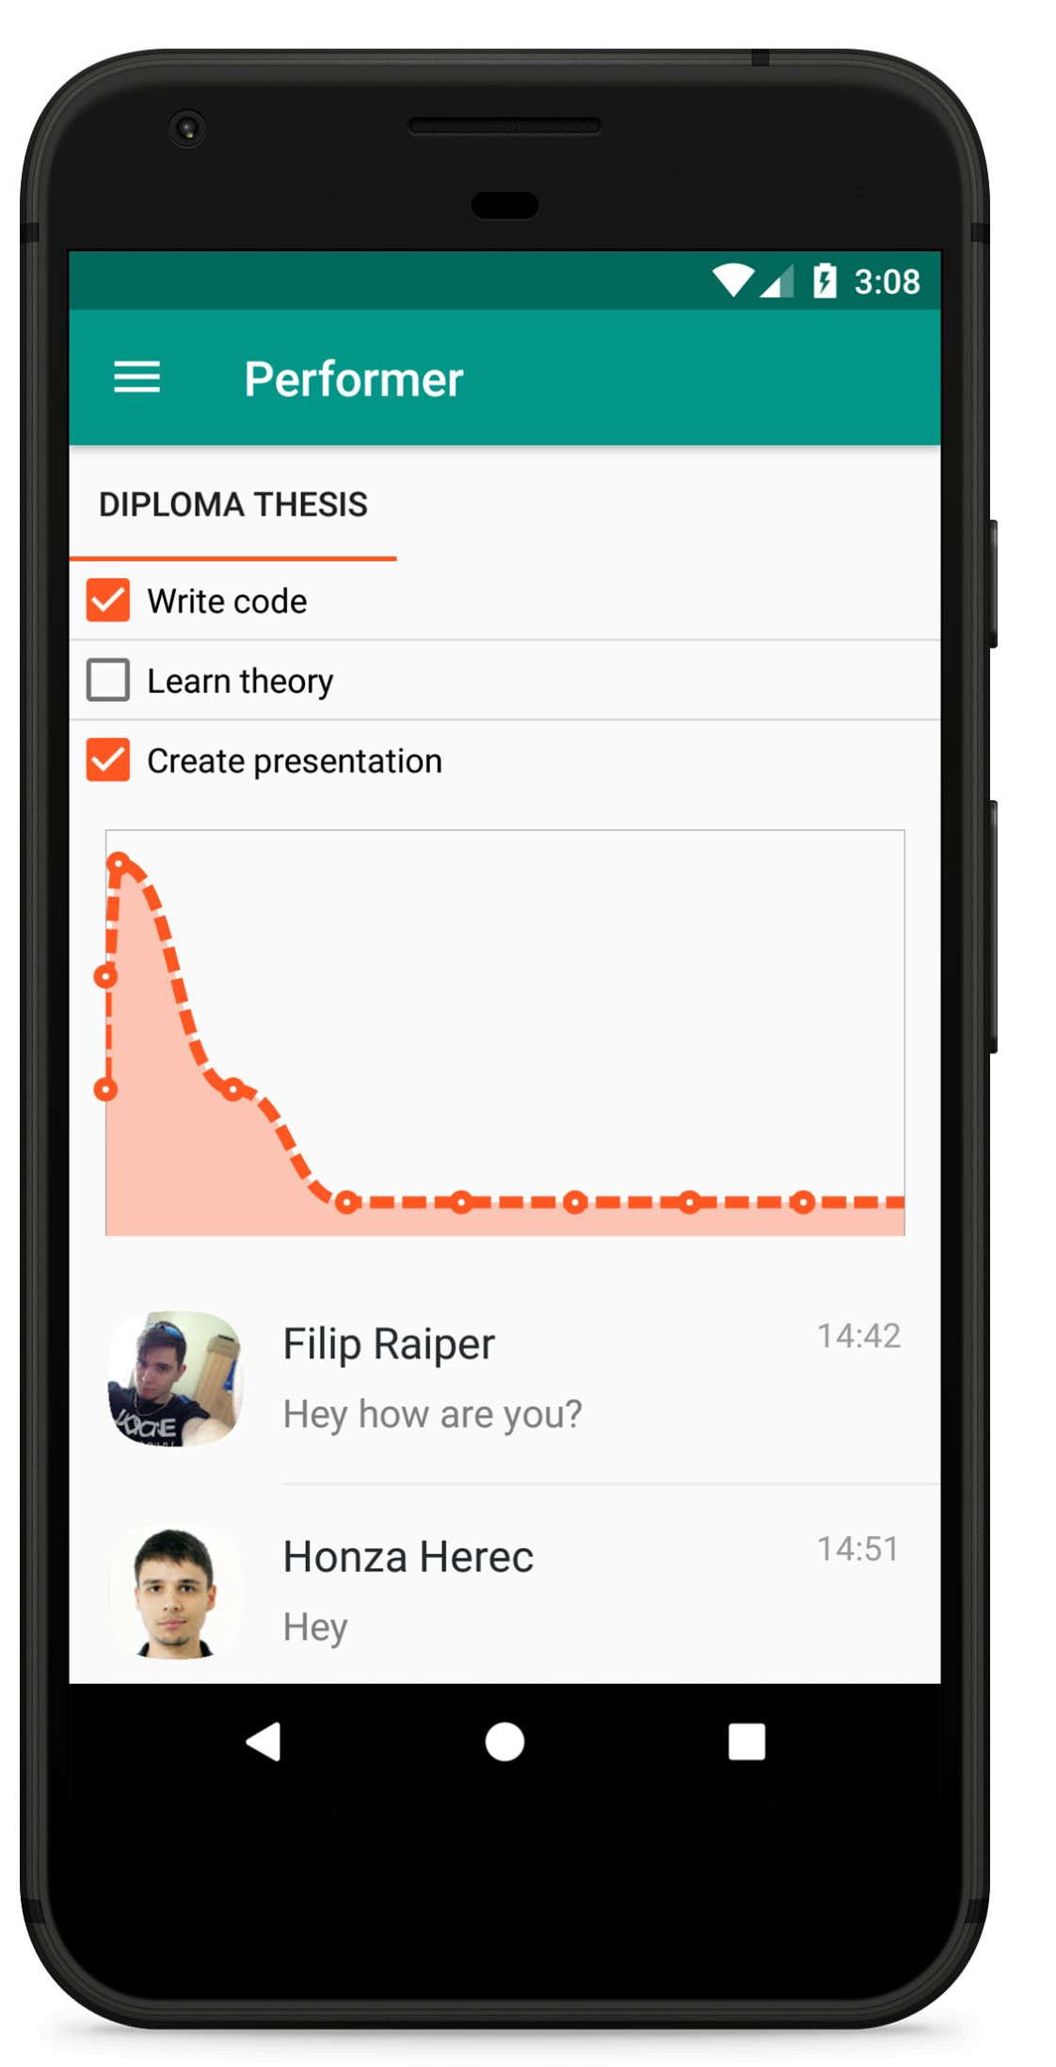
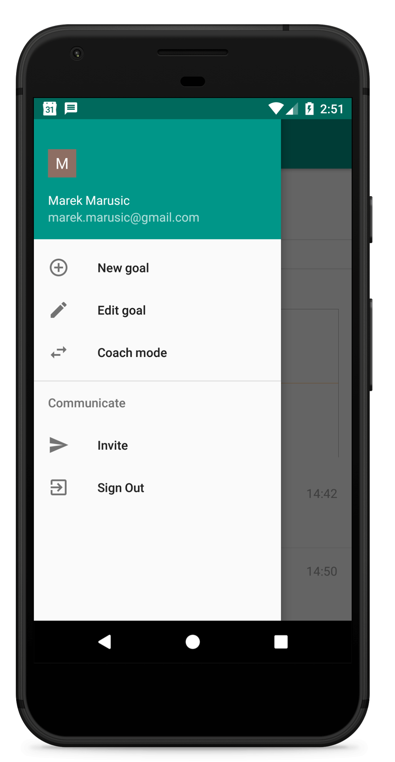
Performer mode
Notes:
Hello, let me introduce our selves and our app micro coaching.
Why this app?
Do you have some goals or dreams for example learn new language or progress with your diploma thesis ?
Are those dreams pushed out of your focus by some other “important” stuff like procrastination or you just forget about them for a long time?
Our app and your friend can help you to focus more and to get more motivation to accomplish your goals by micro - coaching.
You can create new goal and ask your friend to micro-coach you.
Your goals are shown in the performer screen where you can see your todos, grap with your progression and messages from your coach.
The progression is measured by the feeling you send to your coaches in the messages.

Slide 3
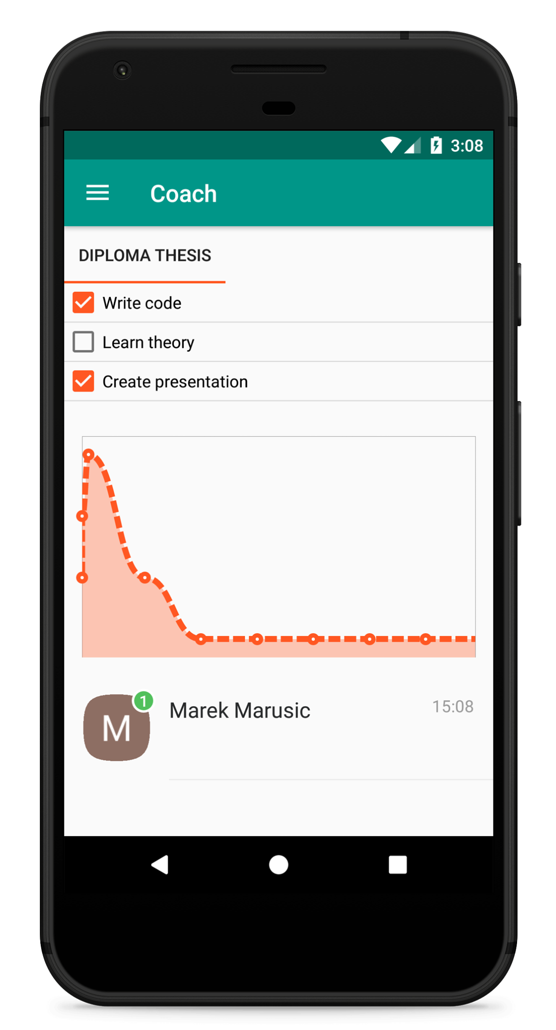
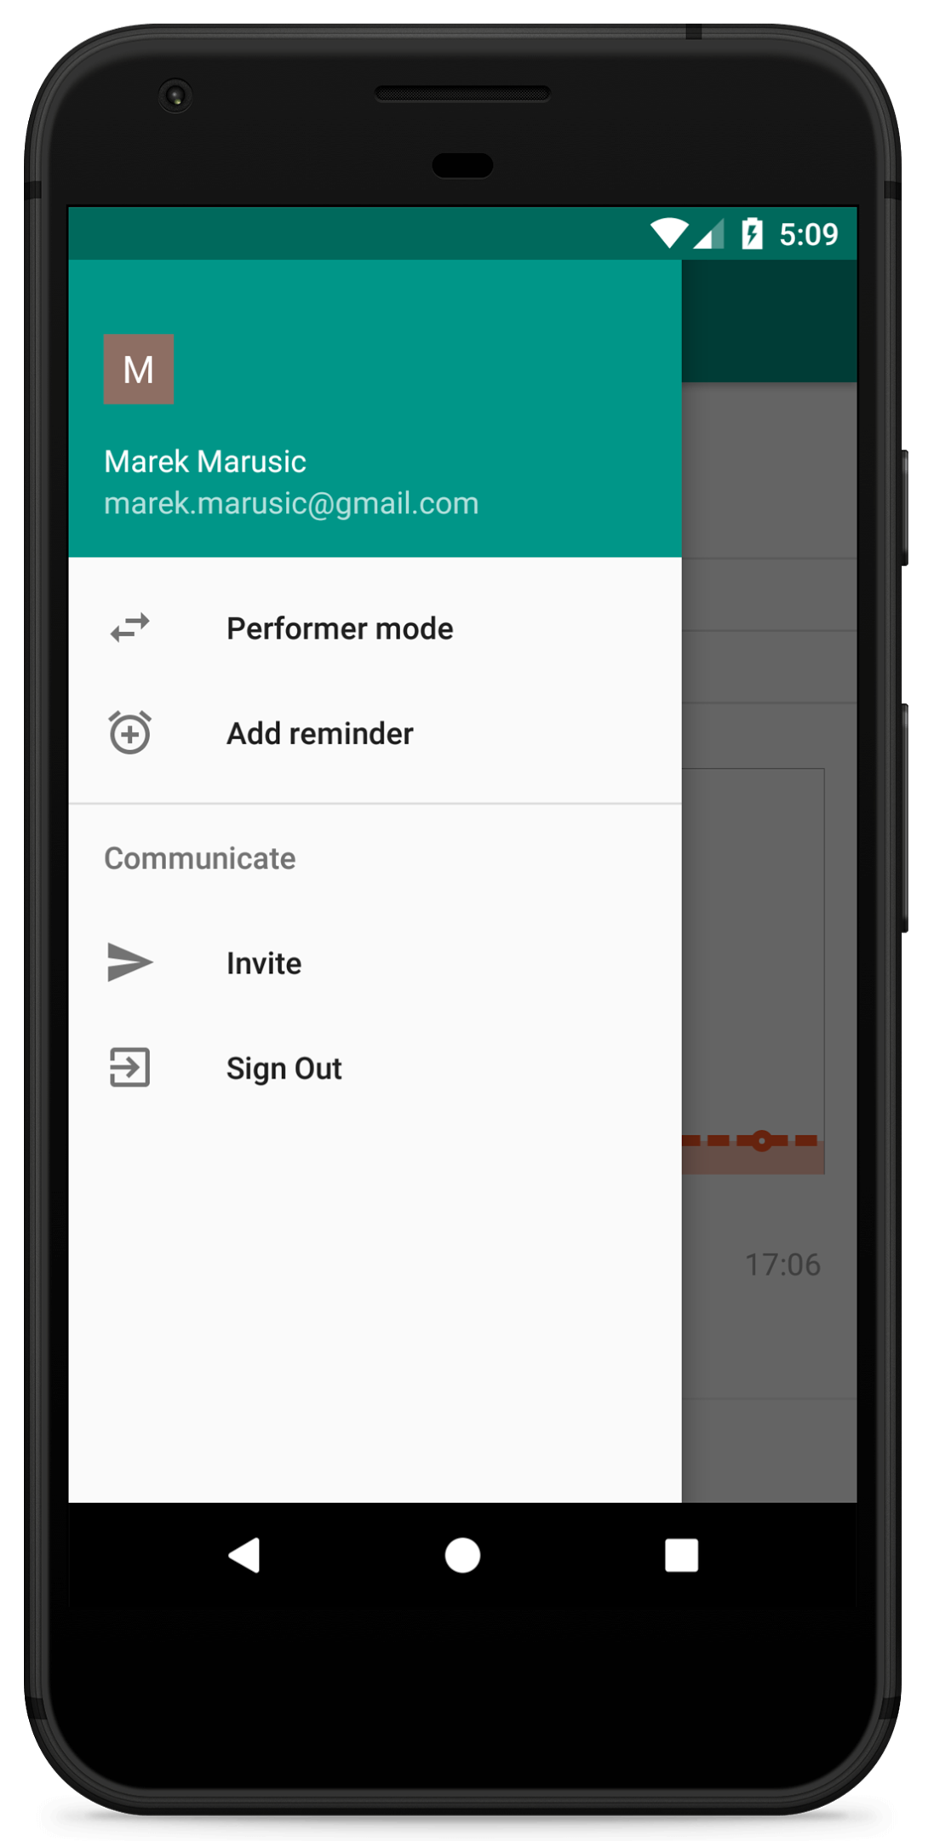
Coach mode
Notes:
Let’s look on the coach mode.
Coach can see the performance of the performer and of course can send him motivational messages to ask about the goal progression and performer’s feeling about his performance.
In case the coach is forgetful he can also set a reminder like “Ask Honza how is he doing on his goal?”. Every coach can create his own goals to perform.

Slide 4
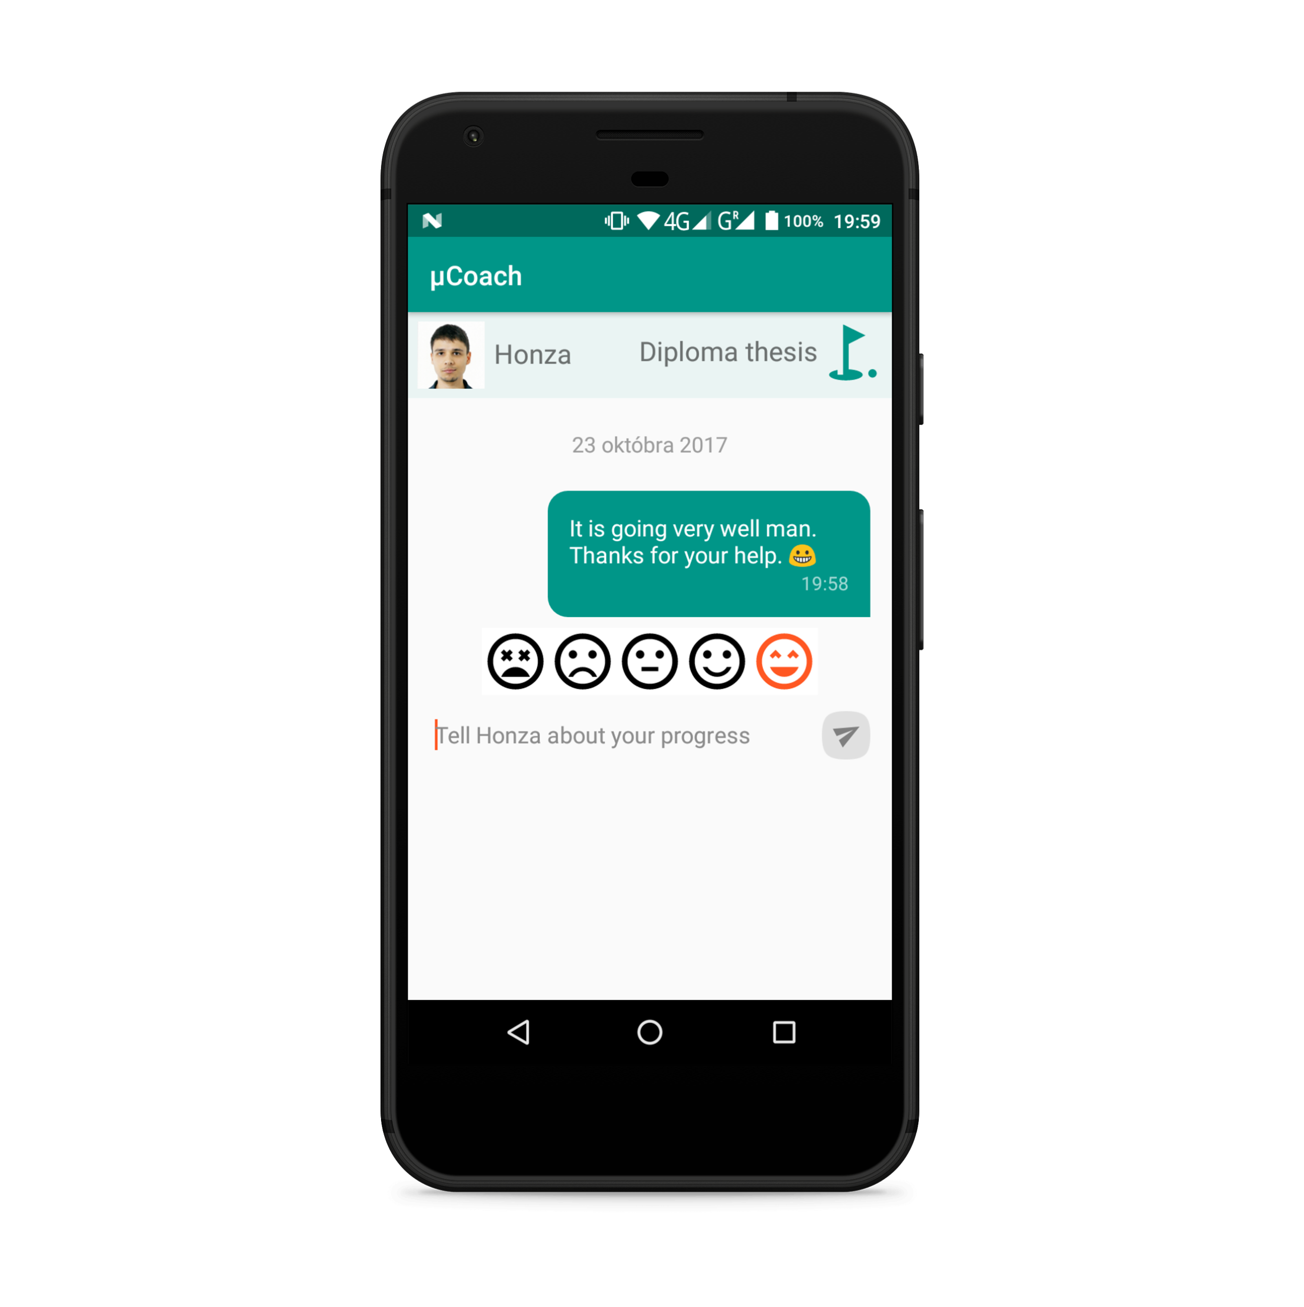
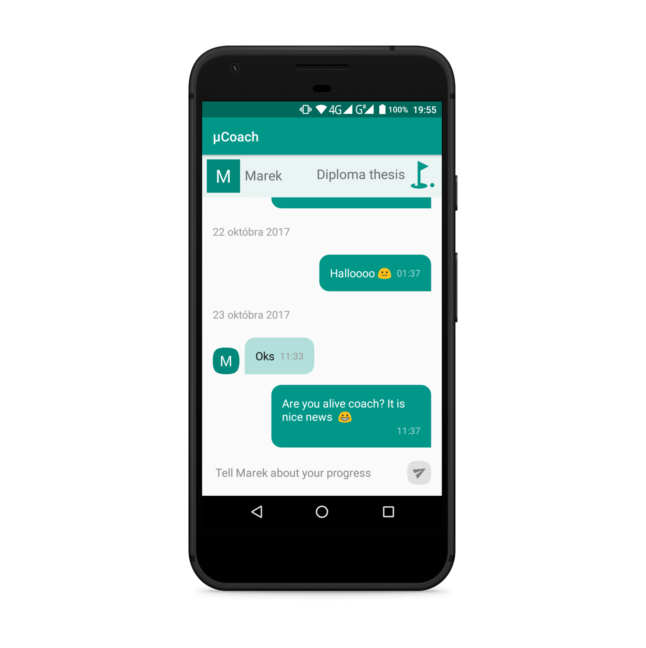
Messaging
Notes:
There is activity of Message and Message history on the screen. In Message you can write message together with rate your progress and see last writen/received message. There are name of chat partner, name of goal in header and very personal text area placeholder. Chat history you can see whole chat history, but it is not supprise :-D.

Slide 5
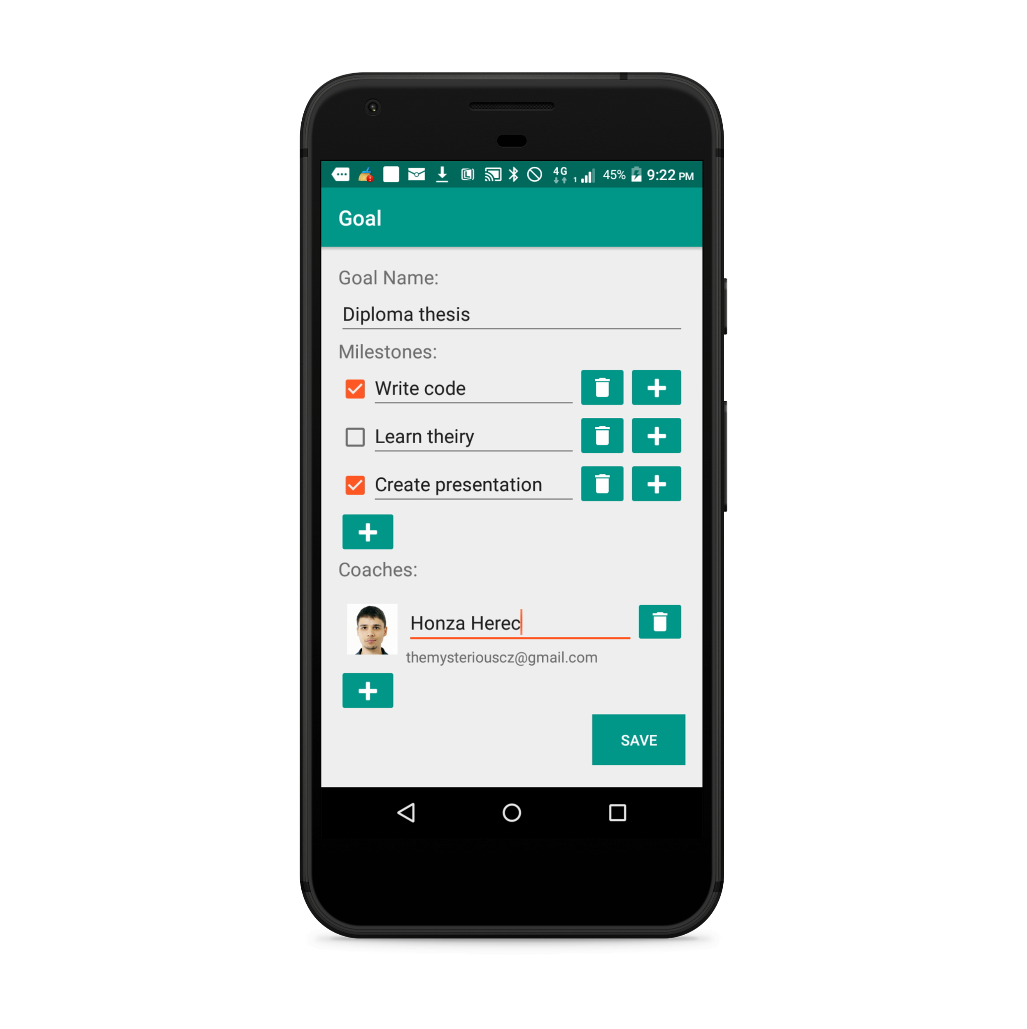

Goal creating/editing
Notes:
Performer can create goal or edit created goal, so there is an Activity for this purpouse. In this Activity performer sets goal name, he can also set some milestones and really important is choosing a coach for that goal. On the left picture you can see situation when performer is creating new goal, on the right picture you can see situation when performer is editing goal, there is really one parameterizable Activity for both situations.

Slide 6
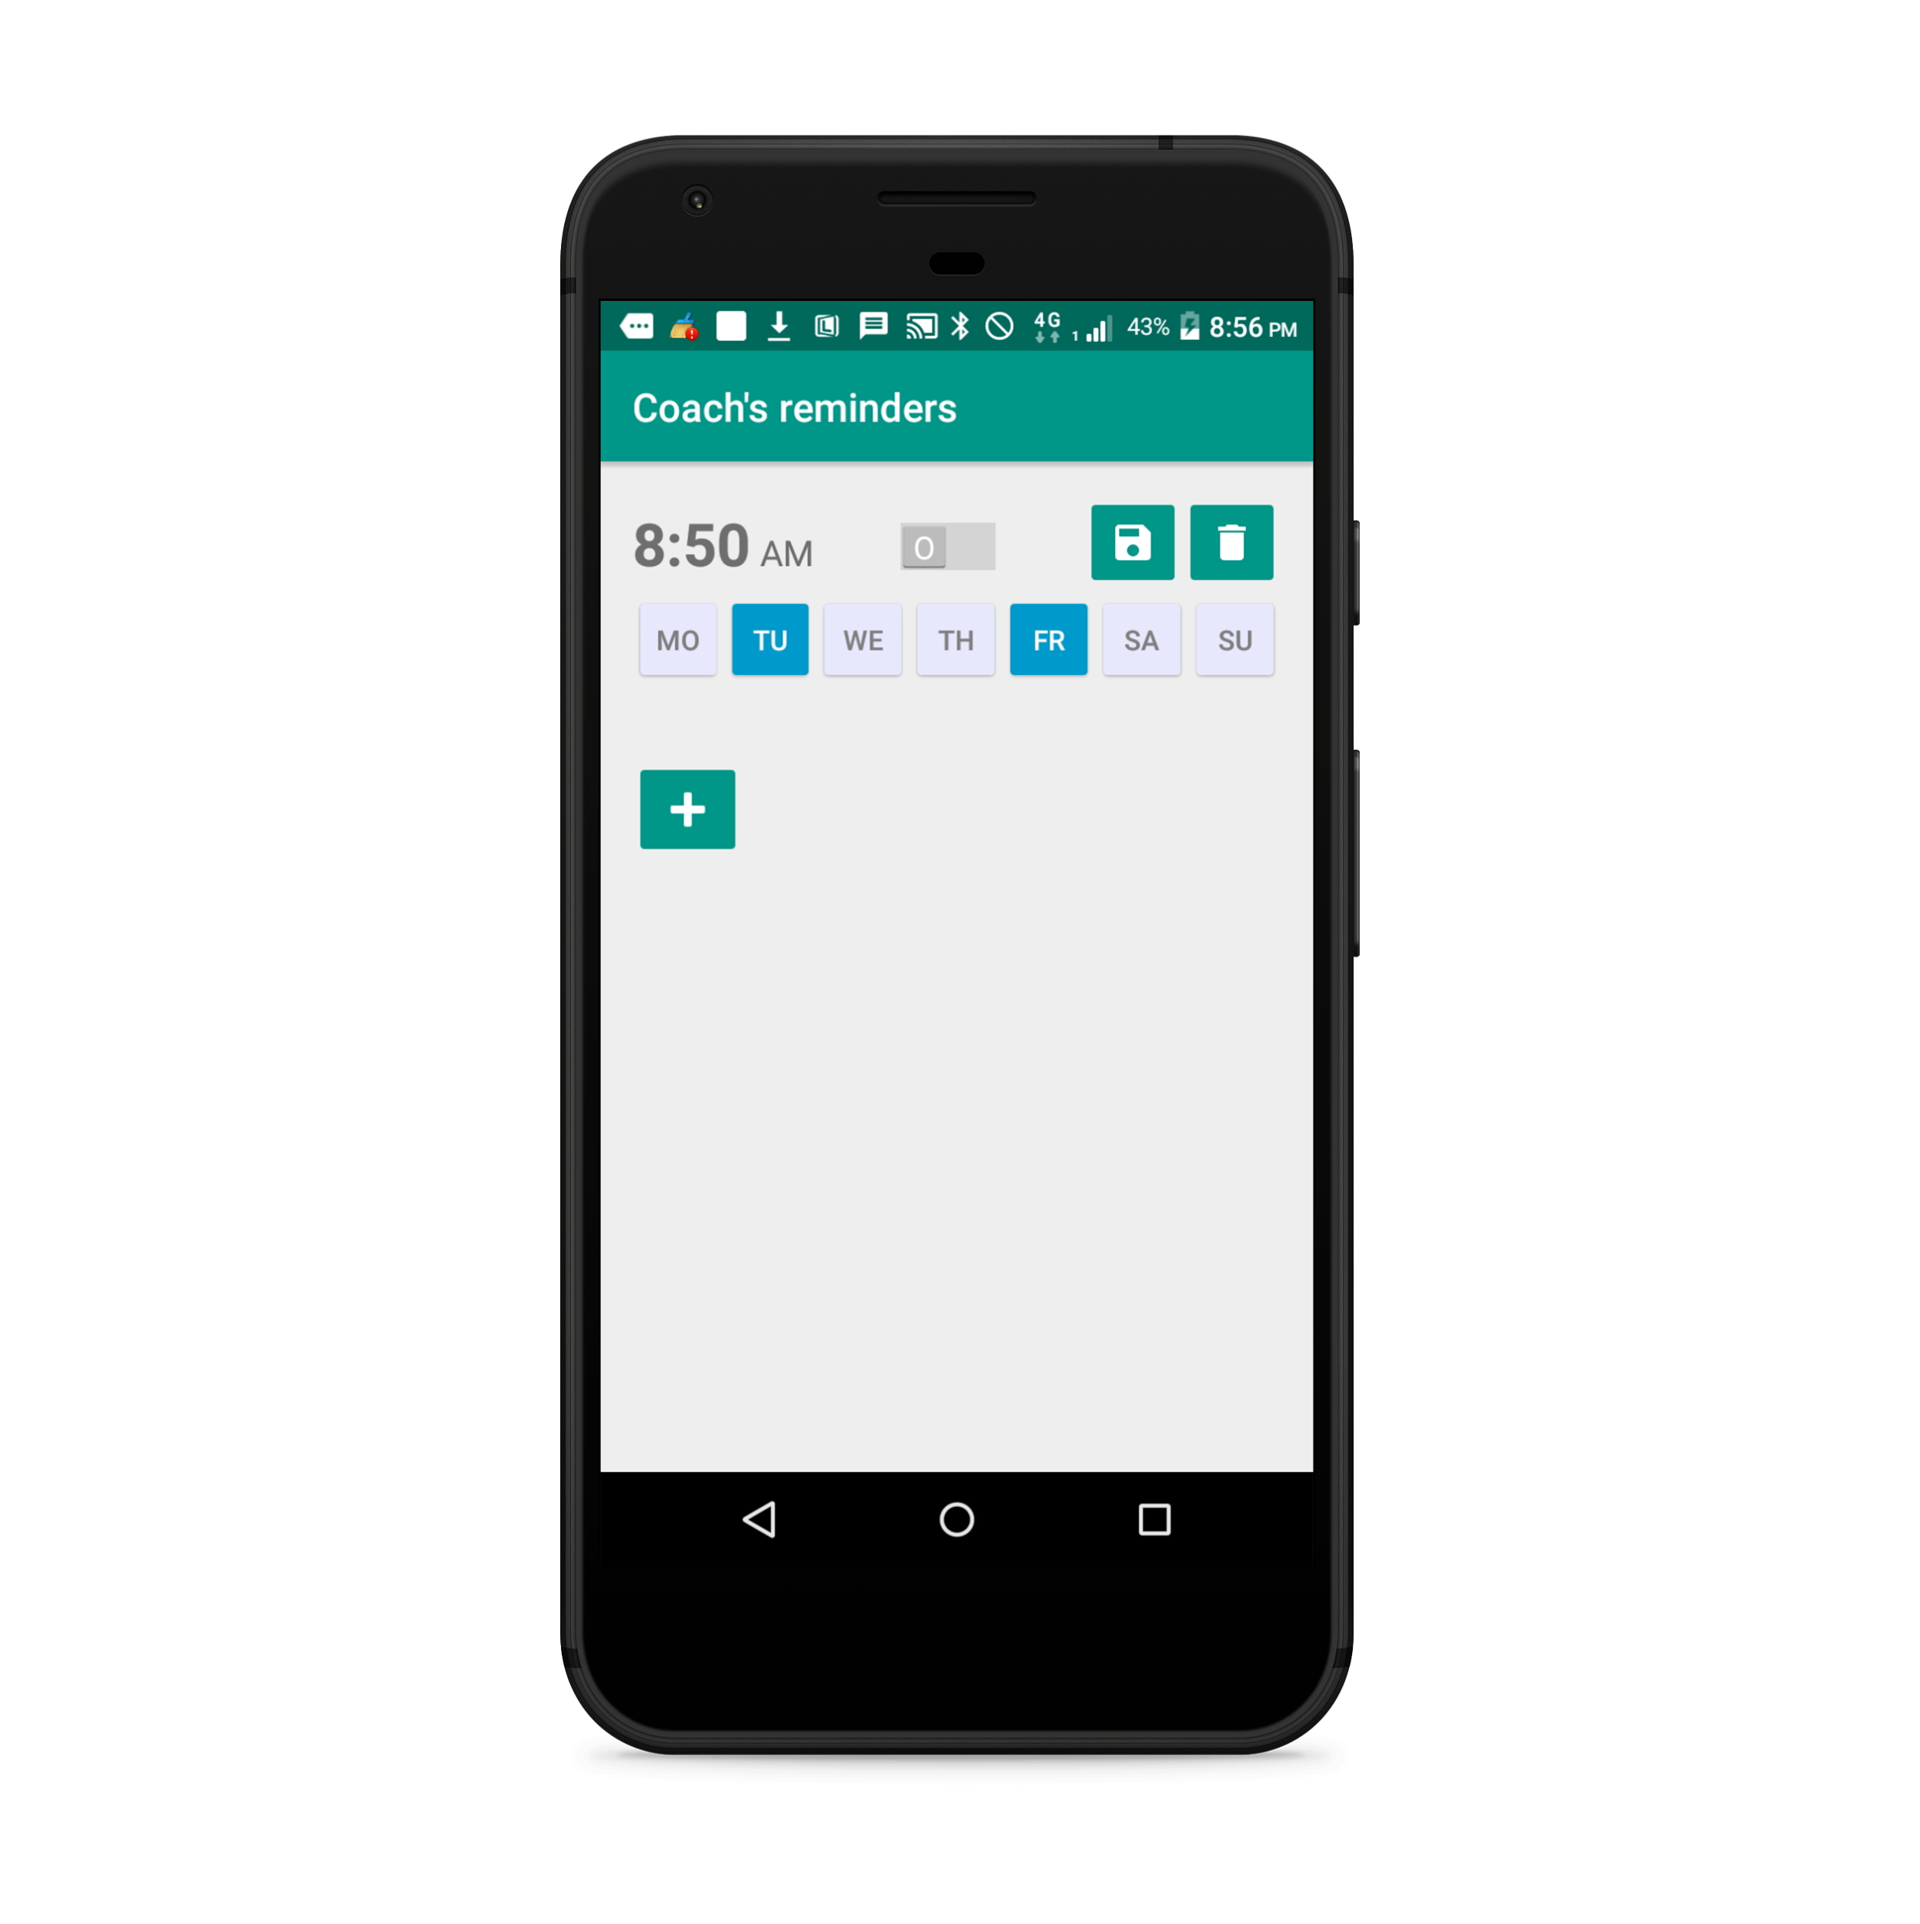
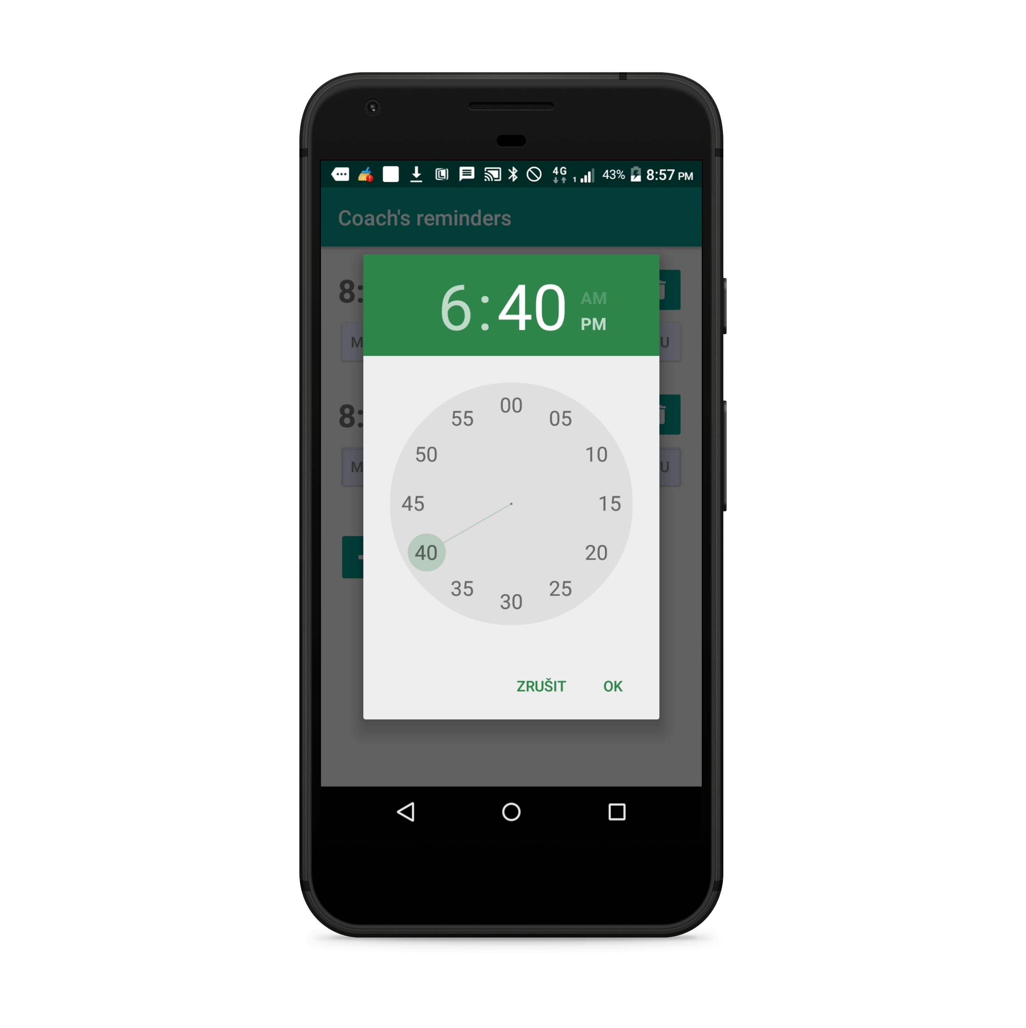
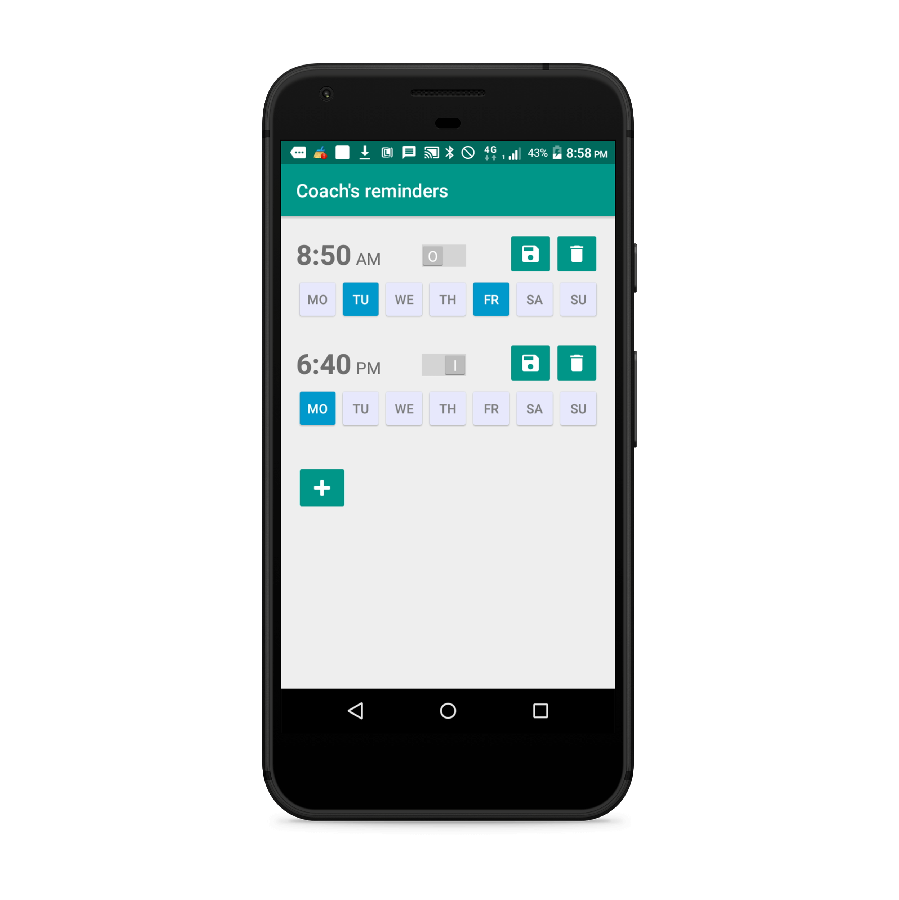
Reminders creating/editing
Notes:
Coach can set multiple reminders for the goal he coaches. Reminders are implemented using android notification system. For particilar reminder coach can set time and days in week when he wishes to be notified. Reminder can be active or inactive. Reminder is implicit weekly. On first picture you can see that coach had setted only one reminder, so he touch + button to add new reminder and he choose time on second picture and on the third picture he also choose monday as day of week when he wishes to b notified.

